Slide 1
Eric Zhao
Final
Presentation

Slide 2
Eric Zhao
DEMO
ericzhao05.com
Page | 01

Slide 3

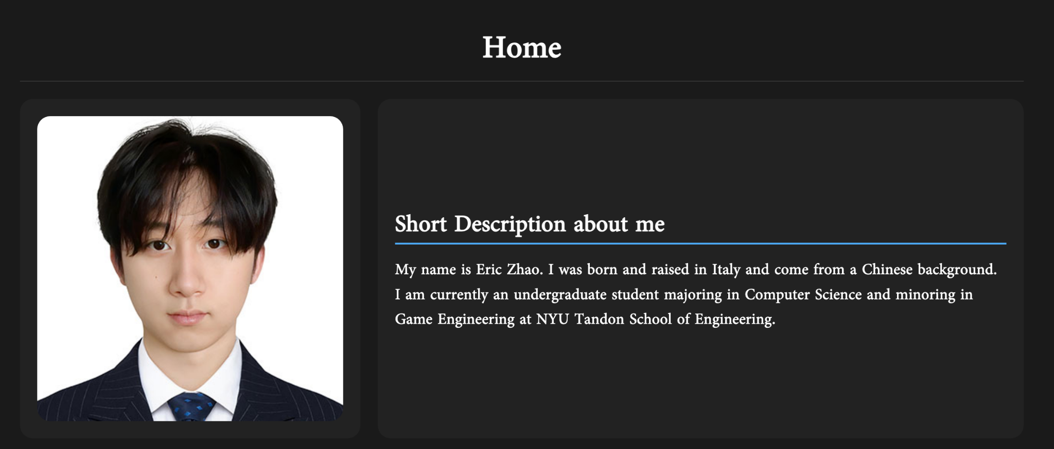
Eric Zhao
Progress
Page | 05

Slide 4
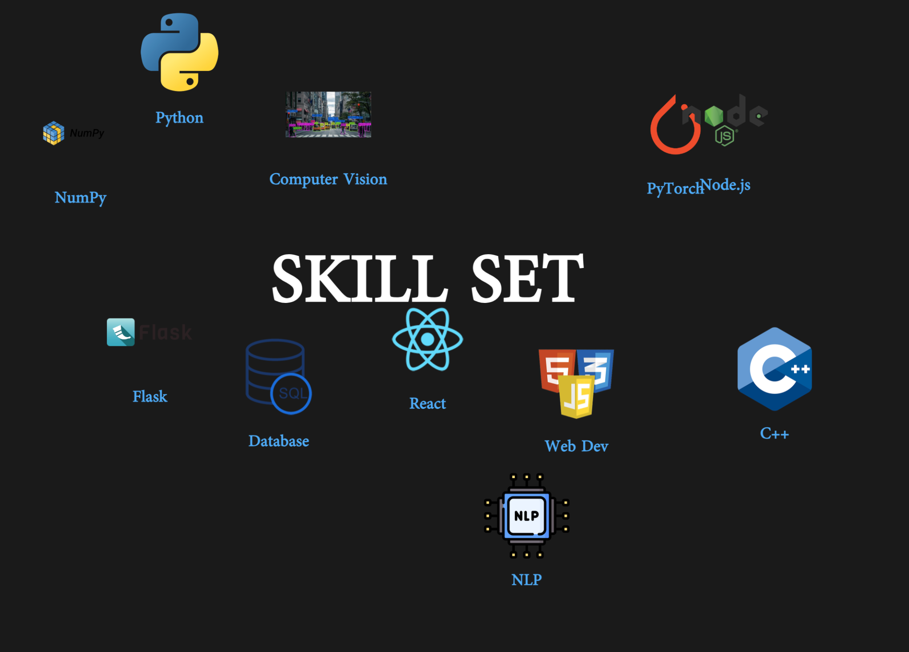
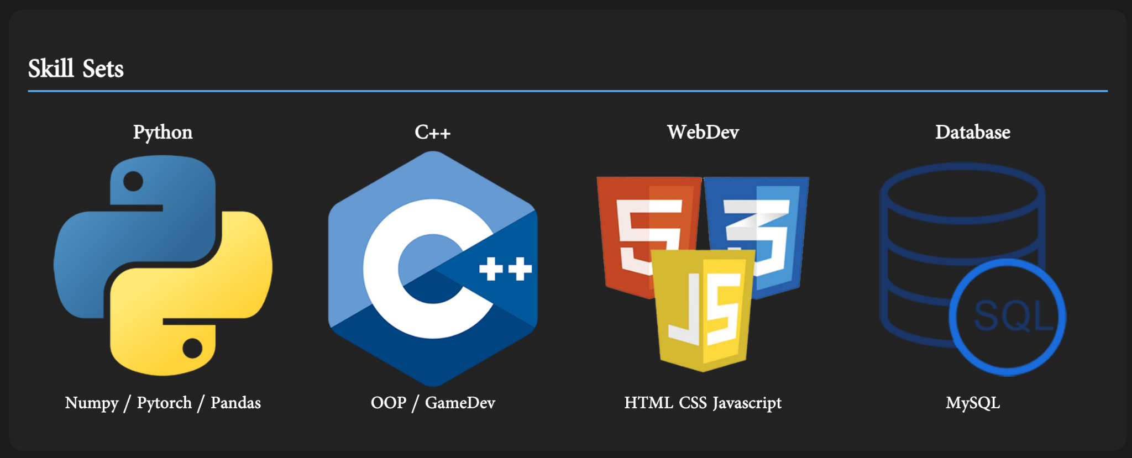
Eric Zhao
Progress
Page | 05

Slide 5
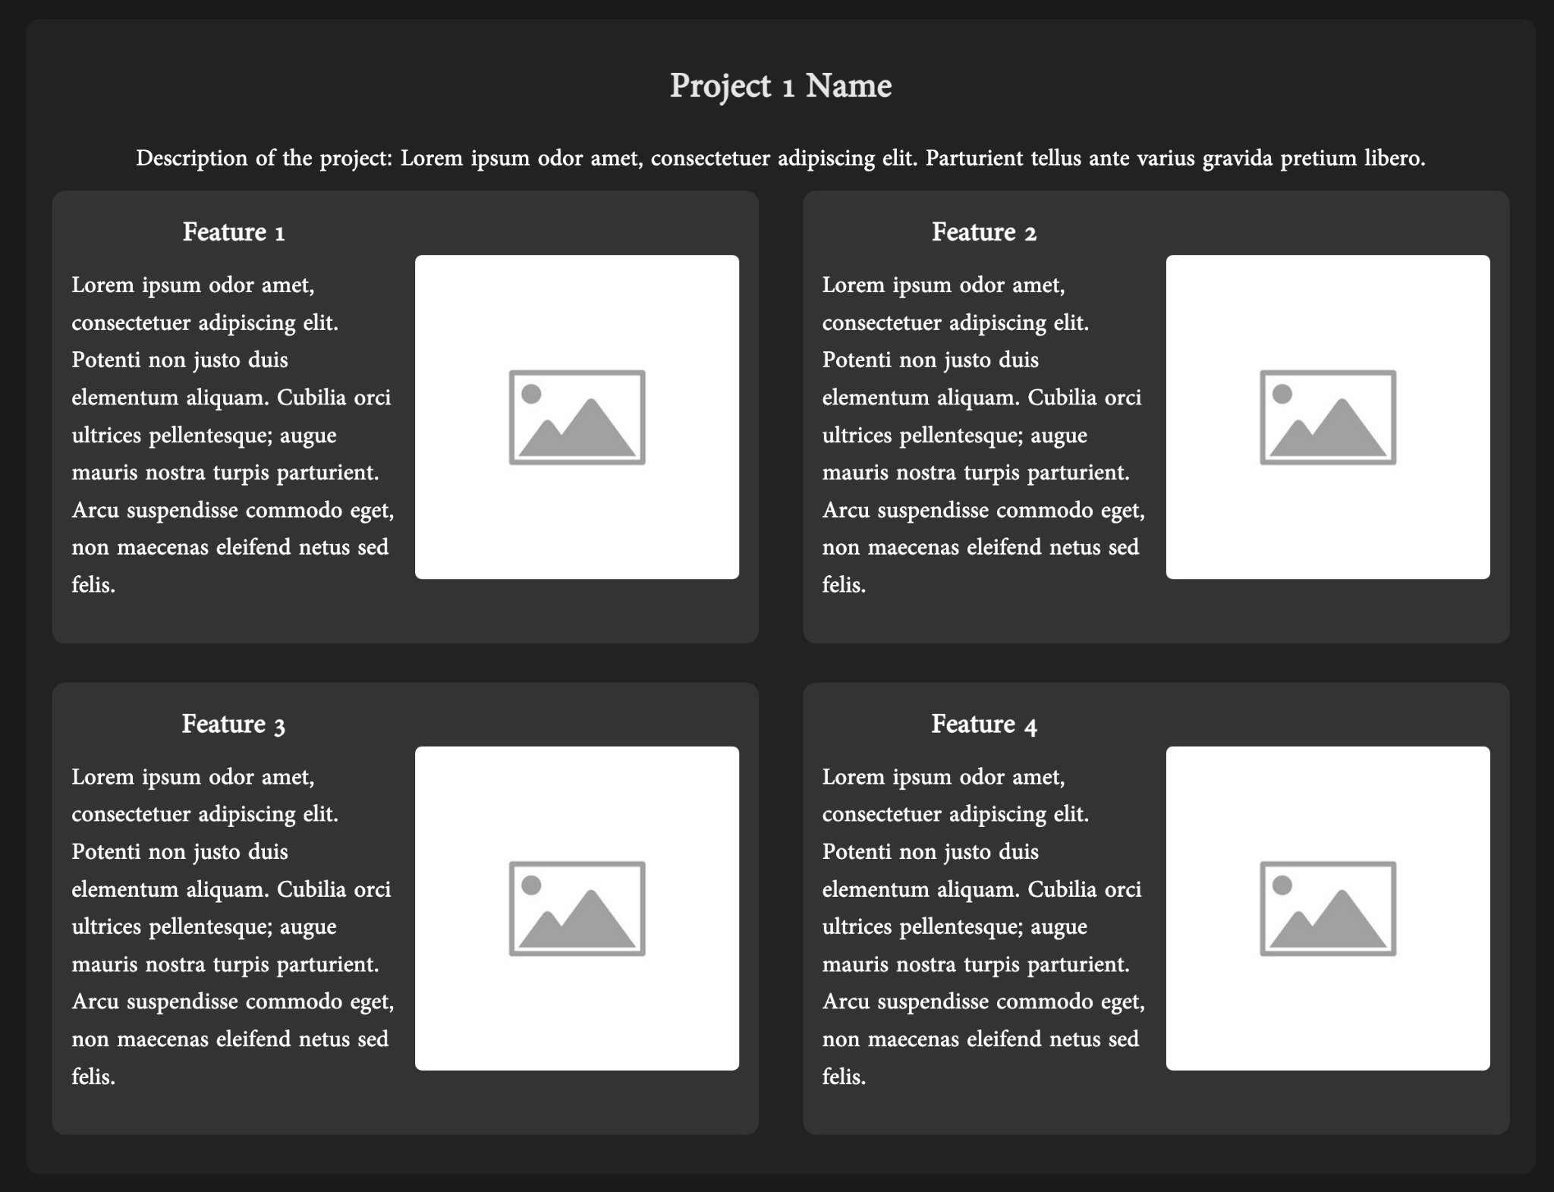
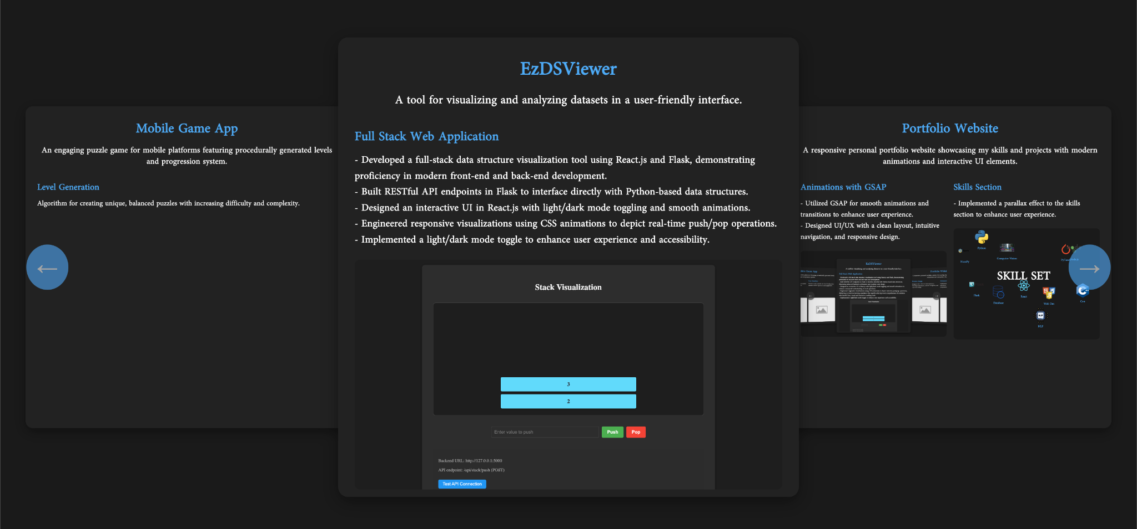
Eric Zhao
Progress
Page | 05

Slide 6
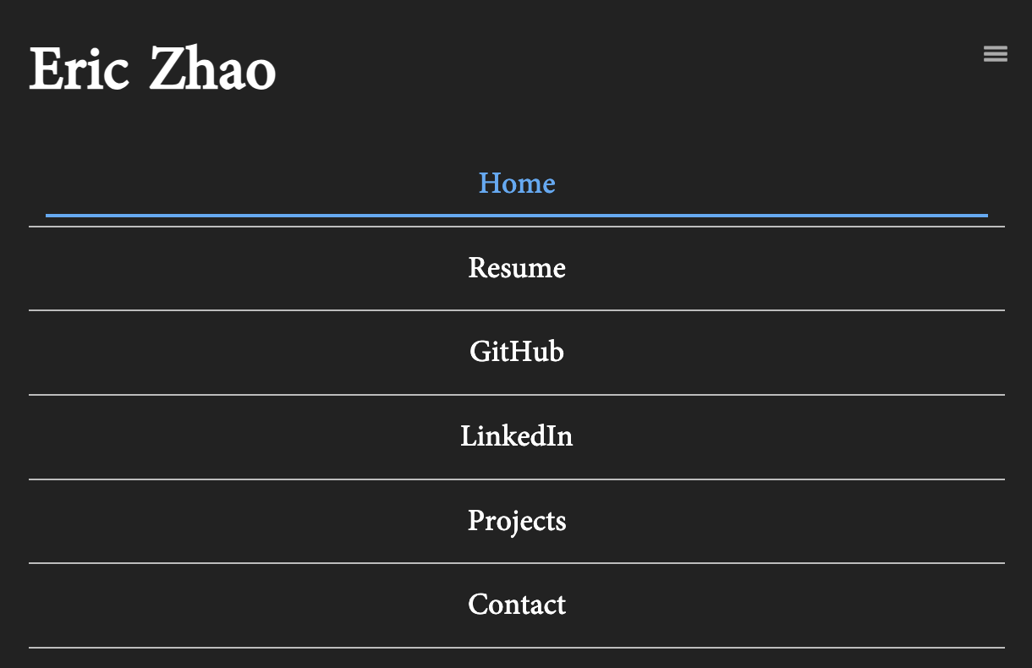
Eric Zhao
Media Query: Mobile
Page | 07

Slide 7
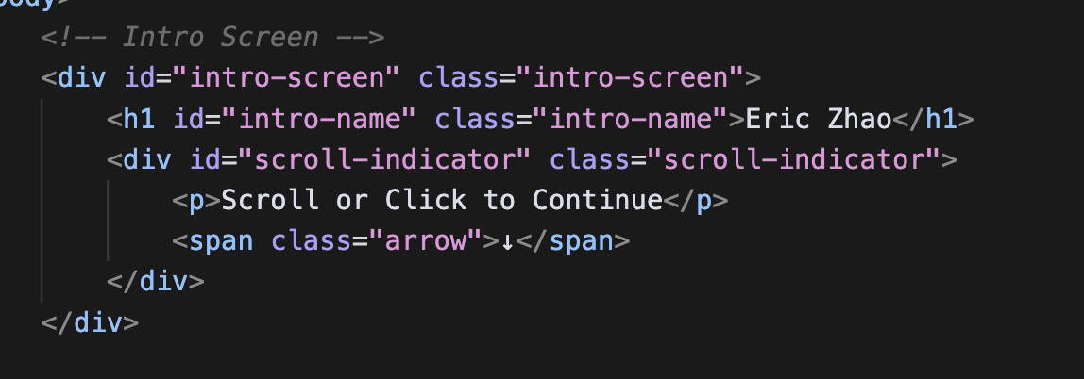
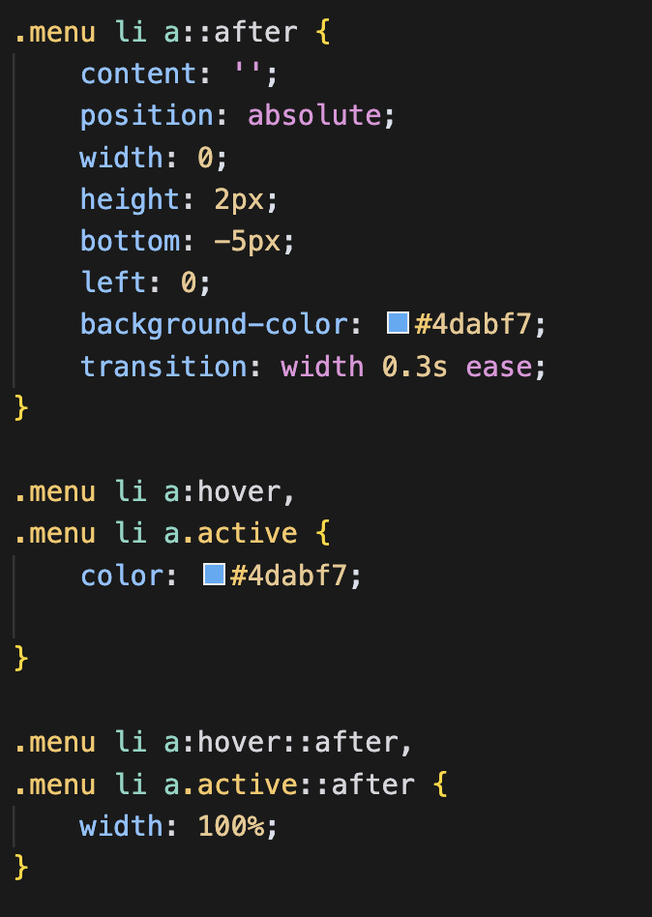
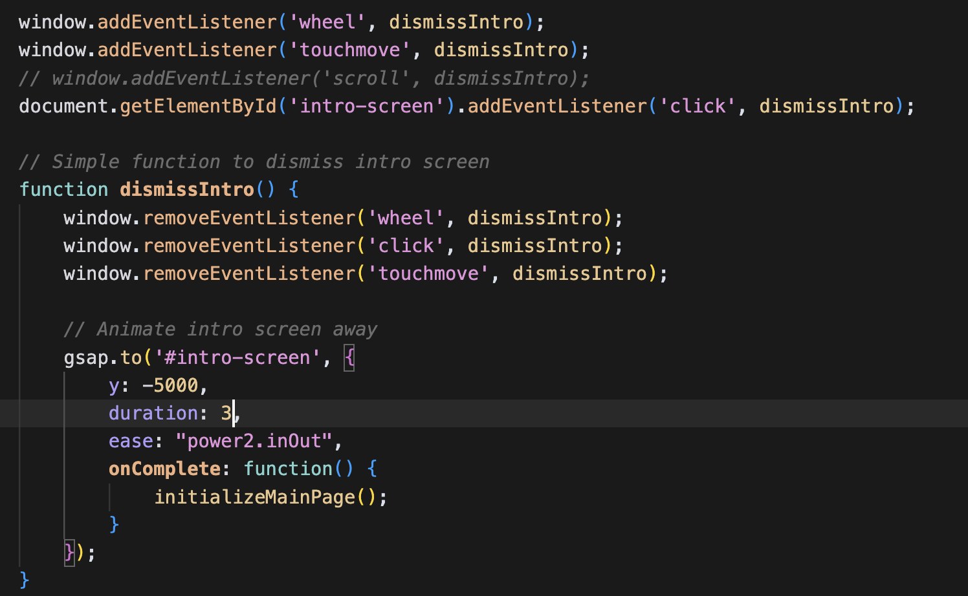
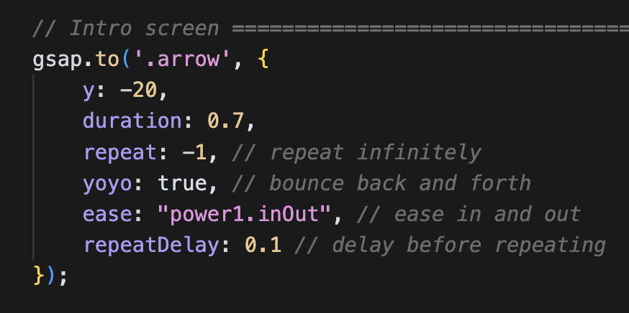
Eric Zhao
Code Snip
Simple GSAP Animation for the Intro Screen
CSS Underline Animation
Page | 06

Slide 8
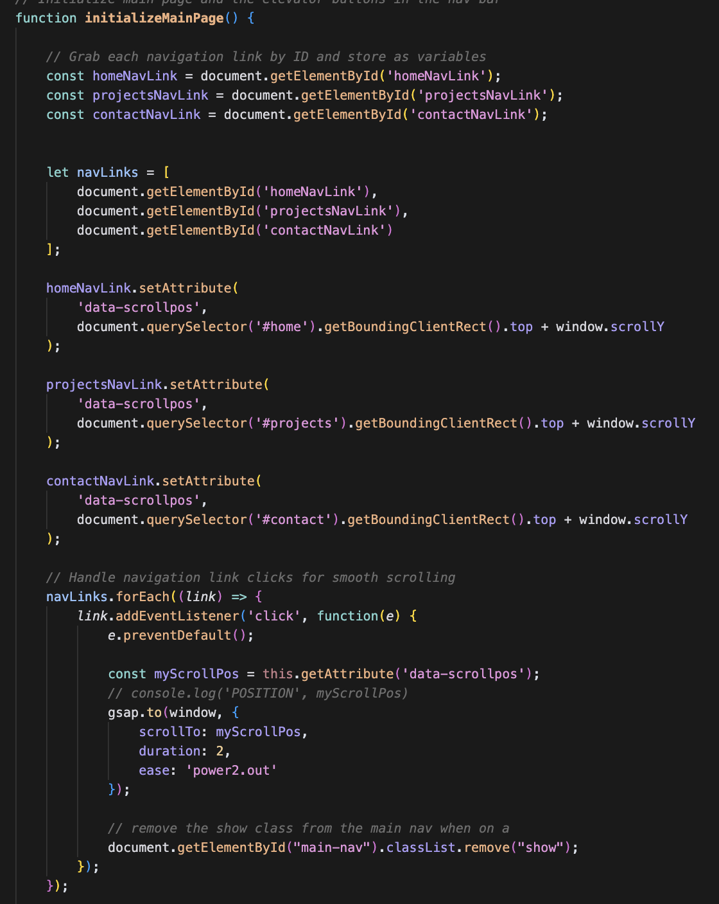
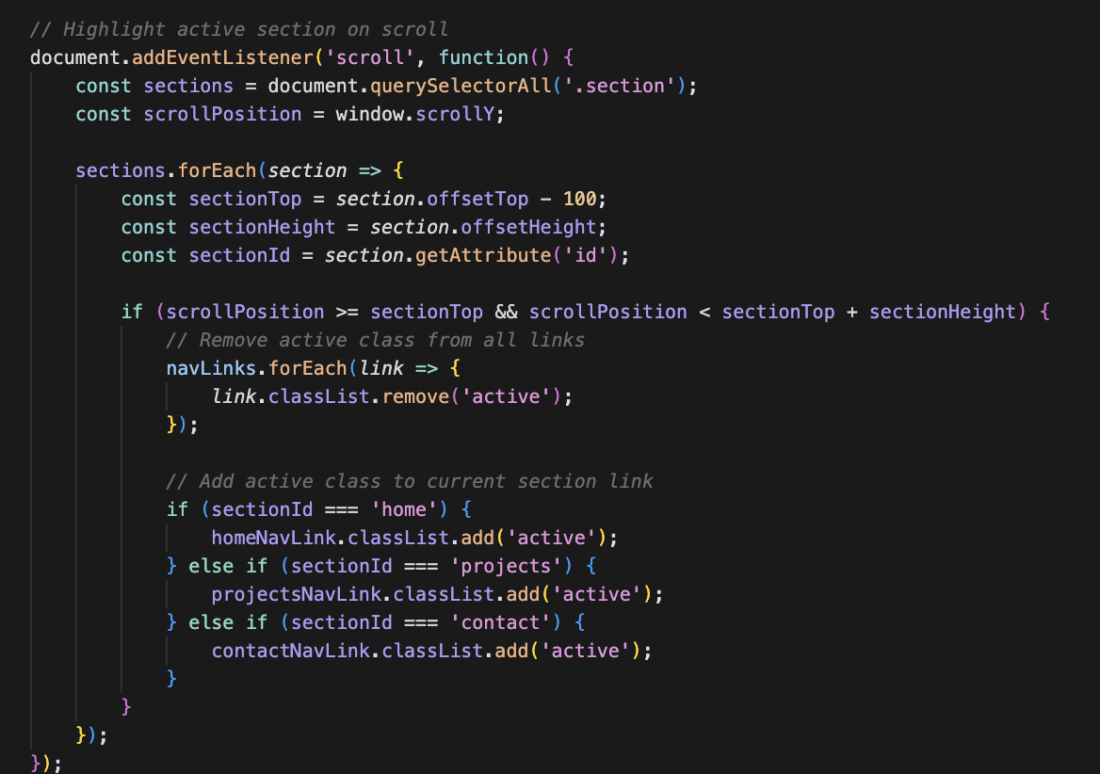
Eric Zhao
Code Snip
Highlight active section on scroll
Elevator Buttons
Page | 06

Slide 9
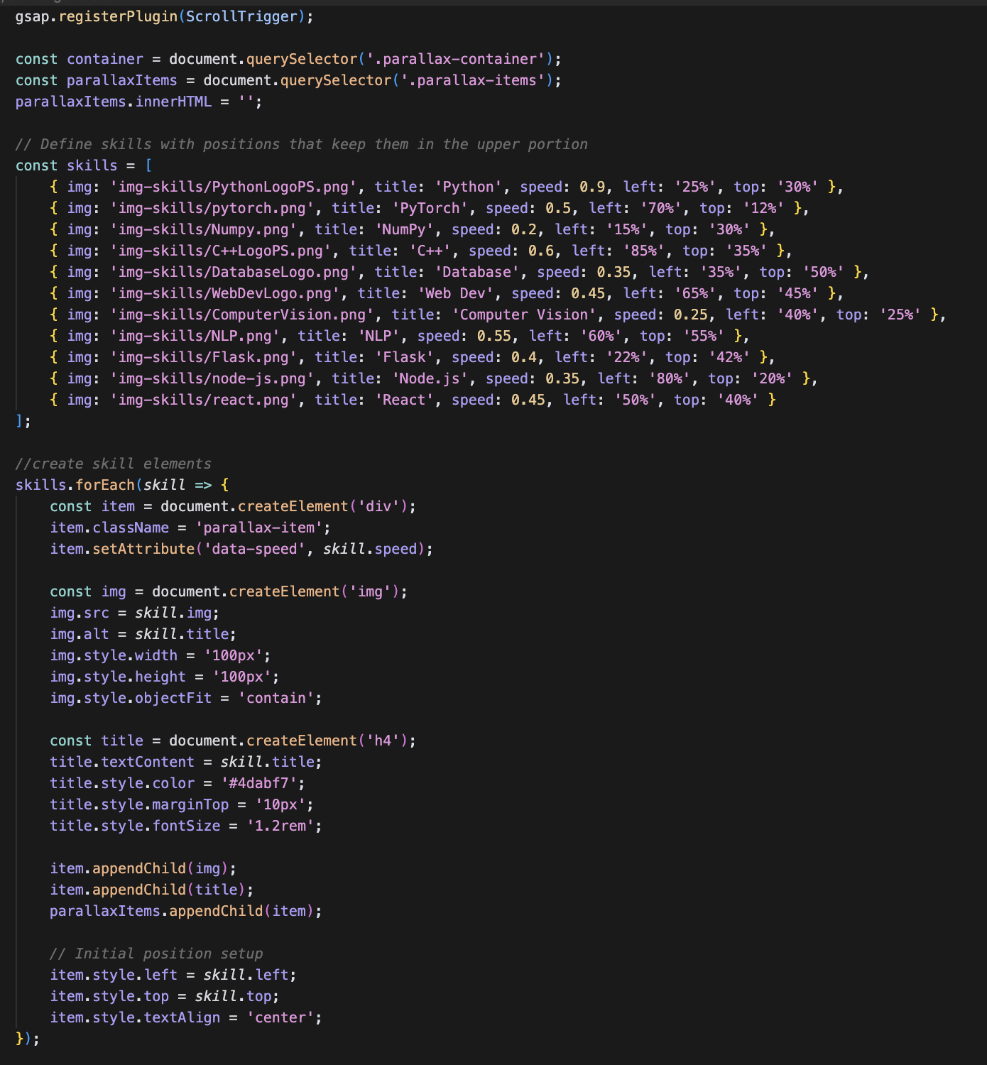
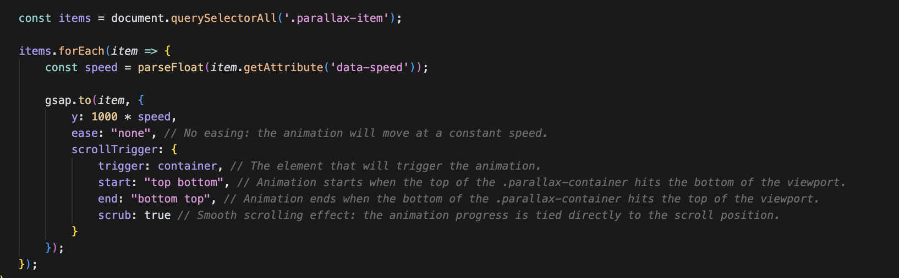
Eric Zhao
Interesting Code
Used GSAP Plugin — ScrollTrigger
Style using Javascript
Page | 07

Slide 10
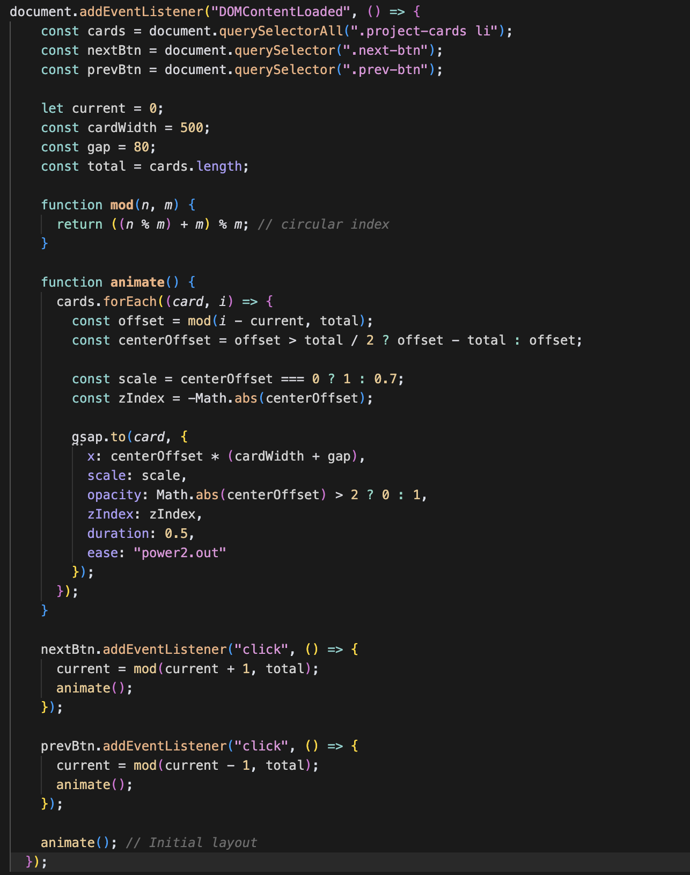
Eric Zhao
Challenge/ Issue
Carousel for Project Display
List of resources used:
https://codepen.io/GreenSock/pen/RwKwLWK
https://glidejs.com/
https://codepen.io/chingy/pen/yLLZRbj
https://codepen.io/Mrrowlie/pen/bGbLOdv
https://codepen.io/tutsplus/pen/MWZwrGJ
Page | 07

Slide 11

Eric Zhao
Concepts I learned
HTML
How to link to local javascript files
CSS
Use ::after to make underlying animation
Use transform: translateX(-50%) to shift half its own width to center it
Use flex: 1 1 calc(33.333% - 10px):
1 → can grow to fill available space
1 → can shrink when needed
calc(33.333% - 10px) → Make this element take up one-third of the container’s width, minus 10 pixels.
Javascript
Use of GSAP Plugin
How to read and understand javascript code
How to create parallax scrolling effect
Finding the proper spot for elevator using: top + window.scrollY
Window.addEventListener(“wheel”) and (“touchmove”)
Horizontal scrolling using arrows (circular indexing)
item.style.transform = `translate(-50%, -50%)`;
Page | 05

Slide 12

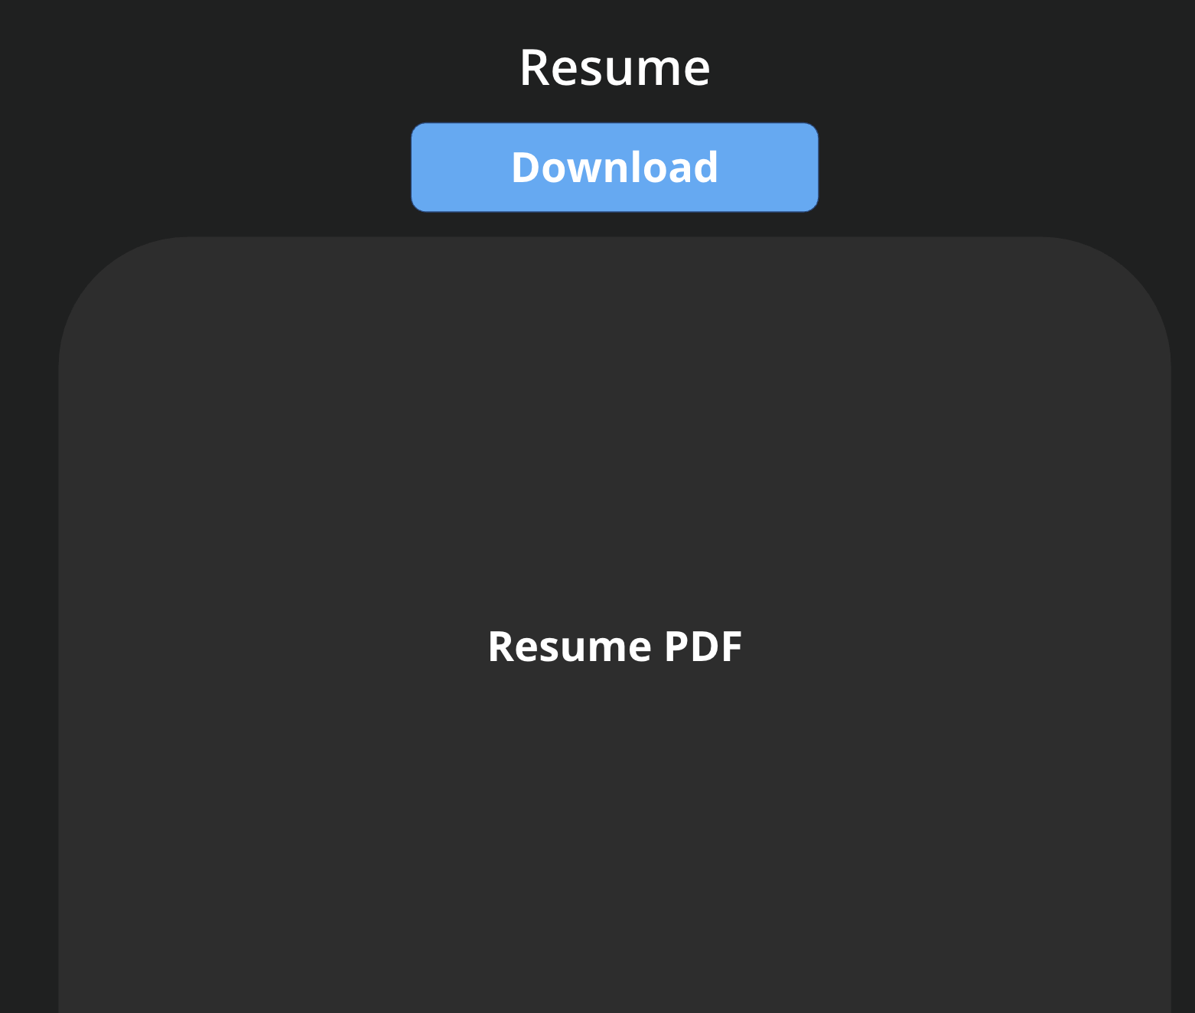
Eric Zhao
Future Steps
Fix media queries for mobile users
Add in more javascript
Type up my resume in HTML
Add a download button for my resume
Implement of scroll animation in my contact page
Fix the intro page (sometimes it behaves weird)
Page | 08

